Slide 1
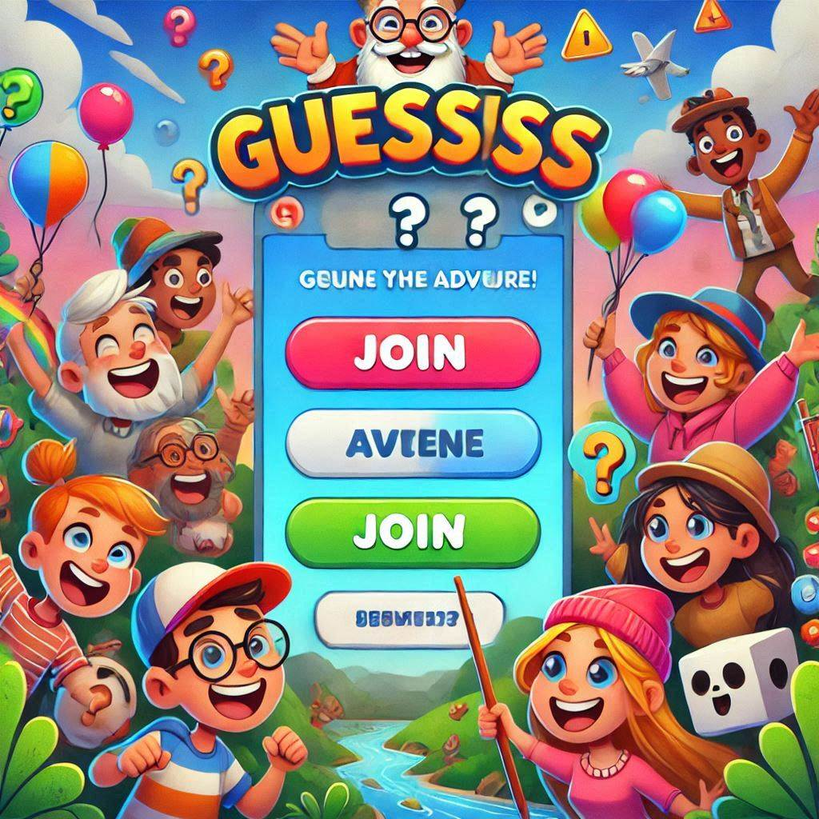
Guess Game Online

Slide 2
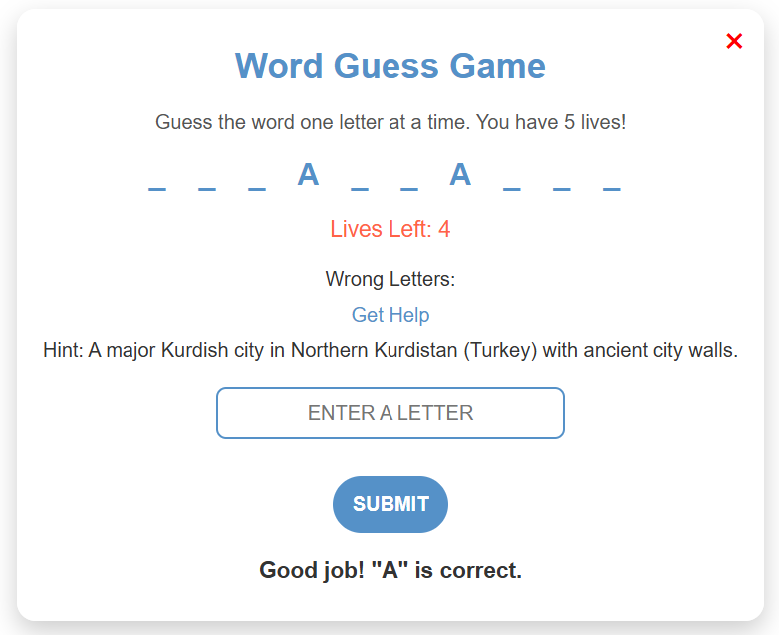
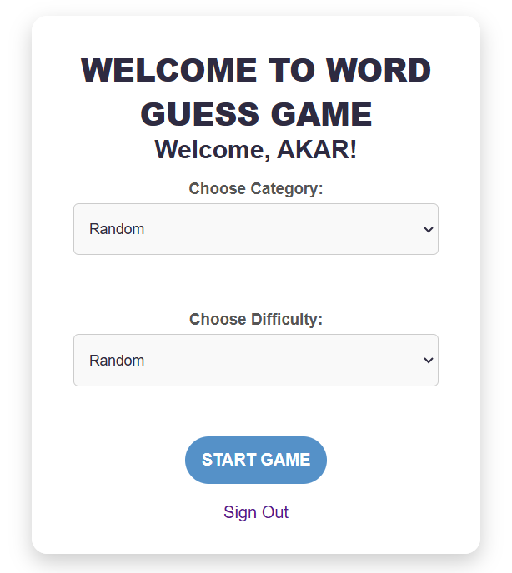
Introduction
Overview: A web-based game that allows users to guess words from various categories and difficulty levels.
Key Features:
User authentication (login/signup).
Word guessing game with dynamic categories and difficulties.
Real-time score tracking and leaderboard.
Technology Stack:
Frontend: HTML, CSS, JavaScript.
Backend: Flask (Python), MySQL (Database).
Data Structures: Hash Tables, Arrays, Queues, Sets.
.

Slide 3
Problem Statement
Efficiently manage user authentication, game progression, and real-time leaderboard updates in an online word-guessing game.
Challenges:
Storing and retrieving user credentials securely.
Managing dynamic game data and user interactions.
Implementing a responsive leaderboard that reflects real-time scores.
Objective:
Use appropriate data structures to handle user data, scores, and gameplay data efficiently.
Ensure a seamless and fast user experience with minimal latency.
.

Slide 4
Game Data Structure & Management
1
Creating an array from the word to be guessed.
2. Using array for storing all words from the
database that are retrieved from the database
.
3. Using SET for storing wrong letters that avoid
duplicate wrong letters
.4. An array for storing score information, like count
the correct guessed word. And calculate the score.
it will be added to a 2d array table in our database
5. When the letter is entered it uses searching for
checking if there is that letter in the word.
.
2
3
4
5

Slide 5
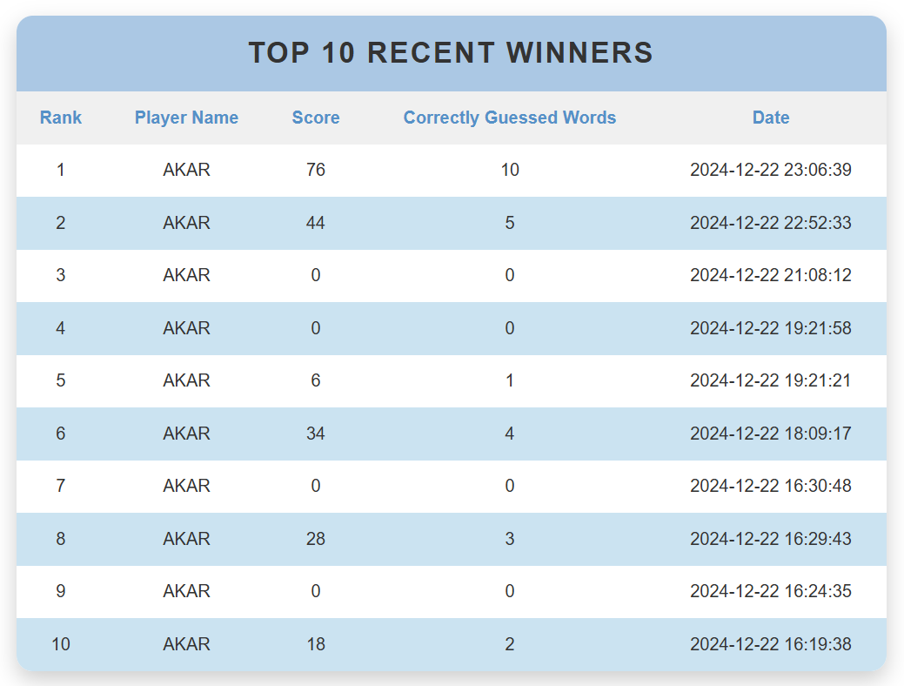
Leaderboard Page & Data Flow
1
Leaderboard Data
2
User’s Last Score
3
Rendering Data with Loops
4
MySQL Database
5
Data Structures Breakdown

Slide 6
Methodology
Approach:
System Design:
Built a modular structure to manage user authentication, gameplay, and leaderboards
Frontend Development:
Designed intuitive interfaces using HTML, CSS, and JavaScript.
Backend Development:
Implemented Flask for server-side logic.
Integrated MySQL for persistent data storage.
Game Logic:
Developed word-guessing mechanics with category and difficulty levels.
Incorporated real-time score tracking and display.
Workflow:
Users log in or sign up.
Select game preferences (category, difficulty).
Play the game with live feedback on correct/incorrect guesses.
Scores and progress are stored and reflected in the leaderboard.

Slide 7
Used Data Structures and Algorithms
Hash Tables:
Usage: Store and retrieve user credentials securely in the database.
Benefit: Enables fast lookup for authentication during login and signup.
Queues:
Usage: Manage the sequence of words for gameplay.
Benefit: Ensures words are presented in order using dequeuing.
Arrays:
Usage:
Store user inputs during login/signup.
Maintain the current state of the guessed word.
Benefit: Simplifies data handling for dynamic updates.
Sets:
Usage: Track unique guessed letters.
Benefit: Prevents duplicate guesses, improving game accuracy.
Algorithms:
Word Selection:
Retrieve random words from the database based on the selected category and difficulty.
Score Calculation:
Calculate points dynamically based on word difficulty and accuracy of guesses.
MySQL Database:
Usage: Store persistent data such as user credentials, scores, and game history.
Benefit: Ensures structured storage and retrieval for scalability.

Slide 8
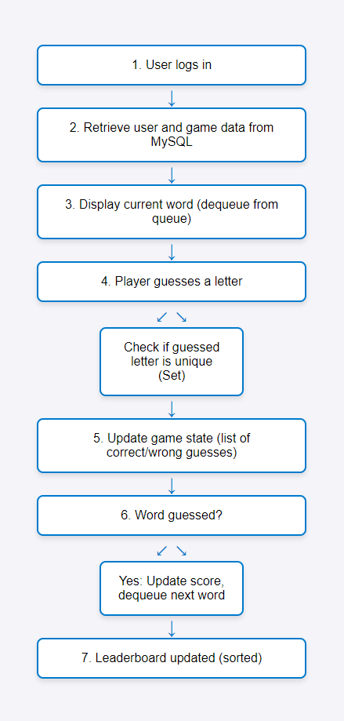
Flow Chart

Slide 9
Future Work
We plan to expand the game into a real-time multiplayer experience, enabling multiple users to play online simultaneously. This will include implementing WebSocket-based real-time synchronization, developing multiplayer game logic, creating user matching and lobbies, and enhancing the database for managing game sessions and scores. Additional features, such as leaderboards, in-game chat, and scalability optimizations, will improve user engagement and system performance.

Slide 10


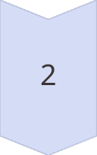
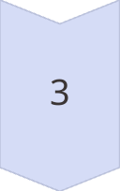
Conclusion
Efficient data structures and algorithms ensure seamless, engaging gameplay.
Secure authentication and a leaderboard enhance user experience.
The project sets a strong foundation for future improvements.

Slide 11
Reference:
McKinney, W. (2017). Python for data analysis: Data wrangling with Pandas, NumPy, and IPython (2nd ed.). O’Reilly Media.
Cormen, T. H., Leiserson, C. E., Rivest, R. L., & Stein, C. (2009). Introduction to algorithms (3rd ed.). MIT Press.
Mitchell, T. M. (1997). Machine learning. McGraw-Hill.
Sebesta, R. W. (2015). Concepts of programming languages (11th ed.). Pearson.
Flanagan, D. (2020). JavaScript: The definitive guide (7th ed.). O’Reilly Media.
Date, C. J. (2019). An introduction to database systems (8th ed.). Addison-Wesley.
Fowler, M. (2019). Refactoring: Improving the design of existing code (2nd ed.). Addison-Wesley.

